Slide 1



NASA ARC FY22-23 Accomplishments
Matthew Johnson
Notable Publications
K. E. Knowland, C. A. Keller, P. A. Wales, K. Wargan, L. Coy, M. S. Johnson, J. Liu, R. A. Lucchesi, S. D. Eastham, E. Fleming, Q. Liang, T. Leblanc, N. J. Livesey, K. A. Walker, L. E. Ott, and S. Pawson (2022), NASA GEOS Composition Forecast Modeling System GEOS-CF v1.0: Stratospheric composition, JAMES, doi:10.1029/2021MS002852.
Chang, K.-L., Cooper, O. R., Rodriguez, G., Iraci, L. T., Yates, E. L., Johnson, M. S., Leblanc, T., et al. (2023). Diverging ozone trends above western North America: Boundary layer decreases versus free tropospheric increases. JGR: Atmospheres, 128, e2022JD038090. https://doi.org/10.1029/2022JD038090.
Daily AQ Forecast Alerts
Continued providing daily ozone and aerosol alerts to 8 TOLNet stations (5 models; 6+ forecast cycles). These alerts have proven useful in identifying opportune times to take observations.
Added NOAA NAQFC ozone forecasts into the alert system.
TOLNet forecast alerts assisted in the network-wide observations (using TMF, TOPAZ, RO3QET, TROPOZ, LMOL, CCNY lidars) of a stratospheric intrusion across the US in 2022.
In addition to the continued maintenance, we are updating the AQ forecast alert system to provide guidance of when to take observations of “clean” and “polluted” conditions for TEMPO val.
Invited Presentations
Johnson et al. (2022), TOLNet Air Quality Forecast Alert System, EPA Stratospheric Intrusion Working Group.
Johnson et al. (2022), Application of TOLNet for investigating wildfire impacts on tropospheric composition and air quality, EPA Region 10 Wildfire Impacts Working Group.
TROPOMI/TEMPO Validation
Participation in the development of TEMPO validation document.
Applying TOLNet for validating TROPOMI ozone profiles (next slide).
CTM/AQ Model Evaluation
TOLNet ozone retrievals used to evaluate the capability of the GEOS-CF model to forecast the impact of stratospheric intrusions on tropospheric composition (Knowland et al., 2022).
Multiple TOLNet stations (TMF, TOPAZ, TROPOZ, RO3QET, LMOL, CCNY) being used to evaluate ozone forecasts from WRF-Chem, GEOS-CF, and RAP-Chem.
Outlook for FY23-24
Continue collaboration to apply TOLNet lidar observations in science studies and outreach to the air quality and modeling community.
Help coordinate best practices for TEMPO validation using TOLNet.
Publish TROPOMI ozone profile validation study.

Slide 2
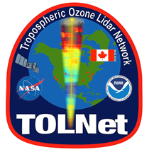
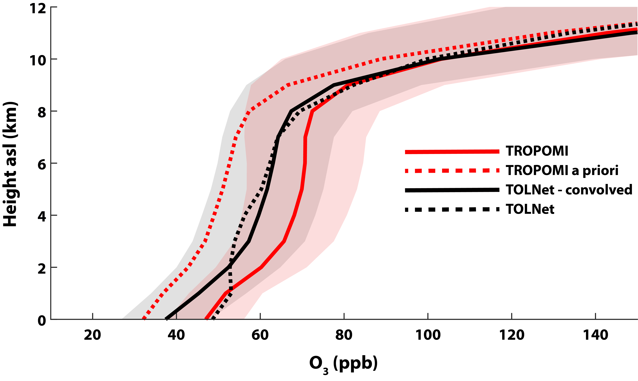
TOLNet validation of TROPOMI ozone profiles in the troposphere: impact of retrieval wavelengths
Matthew Johnson, TOLNet, and Univ. of Bremen teams
Significance:
The NASA Tropospheric Ozone Lidar Network (TOLNet) provides observations which can be used for validating space-borne retrievals of ozone profiles.
The validation of TEMPO ozone profile and PBL-column (0-2 km) products is a major goal of TOLNet in 2023-2024.
Background:
TOLNet acquired hundreds of hours of co-located ozone profile observations in 2018/2019 for TROPOMI ozone profile retrieval validation.
The University of Bremen produced and published an ozone profile product (UV, IR, and UV+IR) for TROPOMI and TROPOMI+CrIS provided co-located retrievals for TOLNet.
Analysis:
Preliminary evaluation and validation of the Univ. of Bremen TROPOMI and TROPOMI+CrIS ozone profile product conducted with TOLNet observations within 25 km and 2 hours of the retrievals.
TROPOMI ozone profile retrievals are also compared to ozonesonde data from NOAA/ESRL/GML, UAH, and LISTOS-2018/OWLETS-2 field campaigns.
Figure 1. TROPOMI UV-wavelength ozone (red solid line) and a priori (dashed red line) profiles compared to raw TMTOL (solid black line) and lidar observations convolved with TROPOMI AKs (dashed black line) in 2018 and 2019.
Results:
TOLNet data is an effective tool for evaluating/validating TROPOMI tropospheric ozone profile retrievals (Fig. 1).
More thorough statistical evaluation of TROPOMI and TROPOMI+CrIS data will be performed going forward.

